Slide 1

Marianne M. Jennings
Business
Its Legal, Ethical, and Global Environment
10th Ed.
Chapter 1 Introduction to Law

Slide 2
Definition of Law
Aristotle
Law is reason unaffected by desire
Holmes
Law embodies the story of a nation’s development through many centuries
Blackstone
That rule of action which is prescribed by some superior and which the inferior is bound to obey

Slide 3
Definition of Law
Black’s Law Dictionary
A body of rules of action or conduct prescribed by the controlling authority, and having legal binding force
Rules Enacted By a Government Authority That Govern Individuals and Relationships in Society

Slide 4
Classifications of Law
Public Law
Enacted by some authorized government body. Example: Federal securities laws
Private Law
Enacted by private individuals
Example: the terms of a lease agreement
Example: employment agreement

Slide 5
Classifications of Law
Criminal versus Civil Laws
Criminal laws are wrongs against society
Civil laws are wrongs against individuals
Substantive versus Procedural Laws
Substantive: Gives rights and responsibilities
Procedural: Means or procedures for enforcing substantive rights

Slide 6
Classifications of Law
Common Law
Began in England in 1066 and continues today
Non-statutory law
Exists in court decisions
Following case precedent, or stare decisis, “let the decision stand”
Statutory Law
Passed by governmental body
Also known as Codified Law

Slide 7
Classifications of Law
Law versus Equity
In common law England, remedies were separated into legal and equitable remedies
Legal = money
Equitable = injunctions, specific performance
Remedies were separated so that courts of chancery could give remedies when courts of law could not
Today all courts are authorized to award legal or equitable remedies

Slide 8
Purposes of Law
Keeping Order
Influencing Conduct
Honoring Expectations
Promoting Equality
Law as the Great Compromiser

Slide 9
Characteristics of Law
Flexibility
Examples: The Internet has required the courts to revisit when a contract acceptance occurs
Consistency
Example: Allows businesses to rely on law for planning

Slide 10
Characteristics of Law
Pervasiveness
Example: Laws covering formation, operation and dissolution of corporations do not unduly interfere with management flexibility

Slide 11
Cases
Case 1.1 Metro-Goldwyn-Mayer Studios v. Grokster, Ltd. (2005)
Downloading: Copyright Infringement or Peer-to-Peer Sharing?
Case 1.2 Viacom International, Inc. v. YouTube, LLC (2012)

Slide 12
Theory of Law: Jurisprudence
Incorporation of Theories or Values Into Definition of Law
Natural Law: Inviolate principles, regardless of laws – human rights
Holmes: “The life of the law … has been experience”
The Social Contract: Law reflects the desires of society for interaction

Slide 13
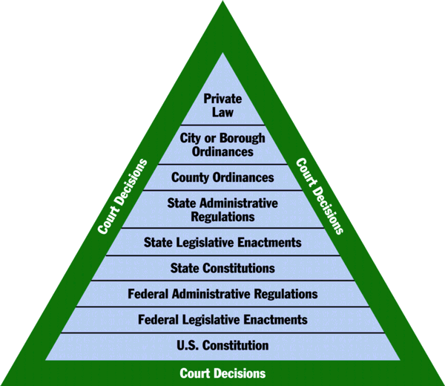
Sources of Law

Slide 14
Sources of Law
Constitutional Law
Exists at federal and state level
Establishes government structure
Establishes individual rights

Slide 15
Sources of Law
Statutory Law at the Federal Level
Enactments of Congress
United States Code. Citation = (e.g., 15 U.S.C. § 77)
Executive orders
Presidential orders
Administrative agency regulations
Code of Federal Regulations. Cite or citation = C.F.R. (e.g., 12 C.F.R. § 226)

Slide 16
Sources of Law
State Laws
Enactments of state legislatures
State Codes
Cite = Nevada Revised Statutes – N.R.S.
State administrative agency regulations
Local Laws
Ordinances
County or city statutes

Slide 17
Sources of Law
Private Laws
Contracts
Leases
Employer regulations
Court Decisions
Language in statute unclear
Court provides interpretation or clarification of law

Slide 18
International Law
Sources
Custom (Country-by-Country)
Treaties
Bilateral—between two nations
Multilateral—among three or more nations
Geneva Convention—prisoners of war
Vienna Convention—diplomatic relations
Warsaw Convention—air travel

Slide 19
International Law
Private Law or Party Autonomy
International Organizations (U.N.)
Act of State Doctrine
Expropriation
Confiscation or nationalization: Taking of private property by a government

Slide 20
International Law
Trade Laws and Policies
Tariffs
Treaties, e.g., GATT, NAFTA
Uniform International Laws
Contracts for the International Sale of Goods (CISG)
Similar To Article 2 of the Uniform Commercial Code (UCC)

Slide 21
International Law
The European Union (EU)
Group of countries in continental Europe
Aiming for barrier-free trade; uniform laws; ease in transaction negotiations and execution
Uniformity in currency, job safety, immigration, customs, licensing, and taxation

